Slide 1
CS 160: Orientation to Computer Science
Introduction

Slide 2
About Me
Software developer for over ten years
Contract C++ programming for Intel, Nike, Tektronix, ESI, and other Portland area companies
Software development business: Creative CyberSolutions
Second term teaching at LCC
Household
Wife
Daughter
Ten chickens
50,000+ bees

Slide 3
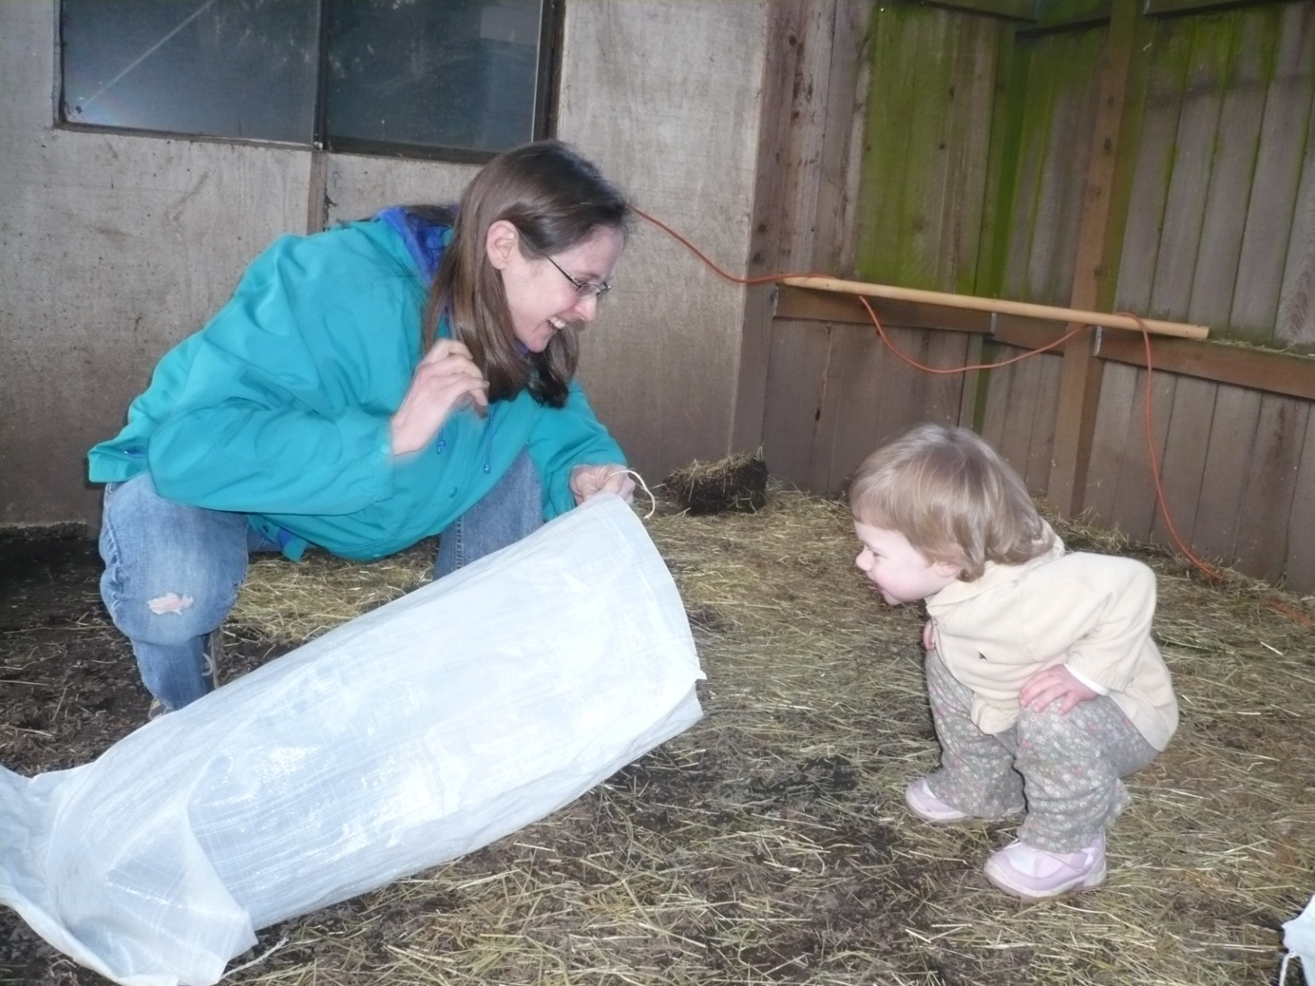
Amanda and Brianna

Slide 4
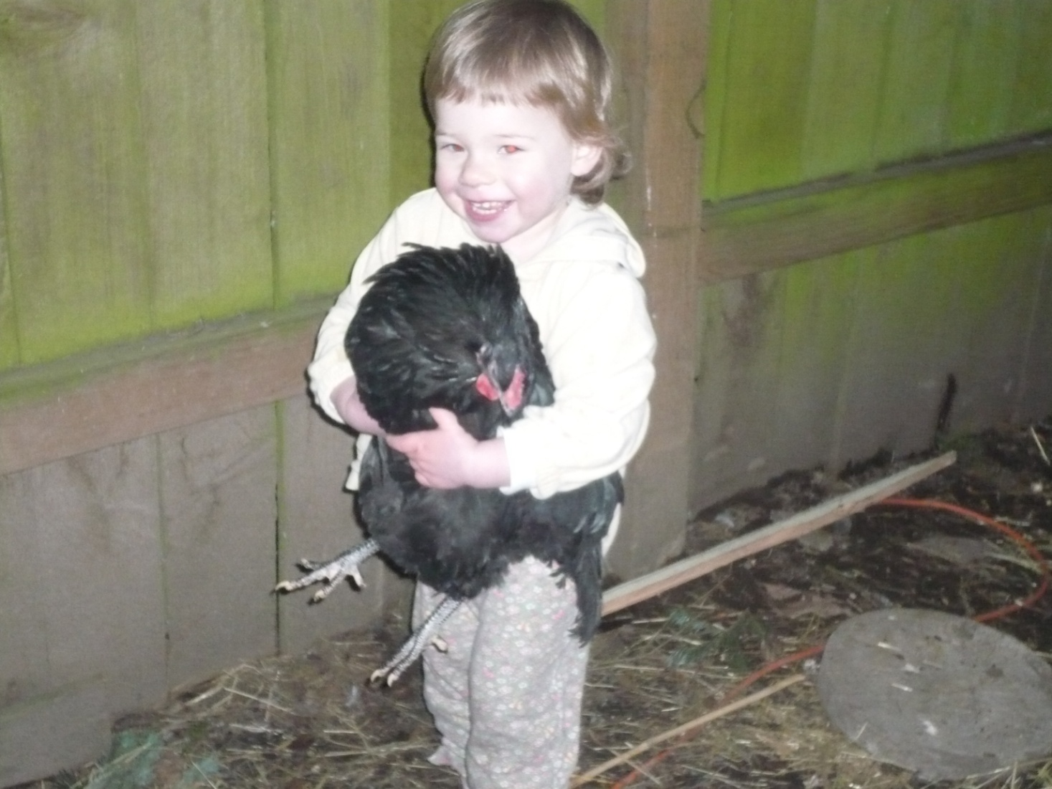
Brianna

Slide 5
About You
How many CIS majors?
How many have written a computer program?
What language did you use?
What do you want to be able to do after you finish this class?

Slide 6
Course Methodology
moodle
Syllabus
Textbooks
Visual Studio 2005
Labs

